Slide 1
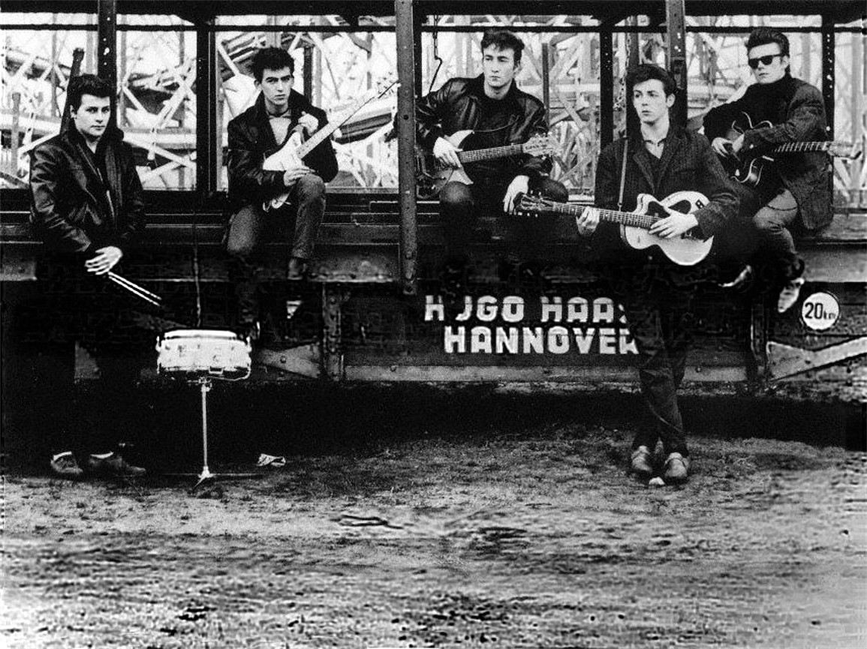
Notes:
Slide 1 - Teaching Notes
1960 - The Beatles in Hamburg
1. Look at this photo of The Beatles in Hamburg. Describe the five people - write their names if you recognise them.
2. Have you seen other pictures of The Beatles? Are they like this?
3. Do you recognise the young man second from the right? What instrument is he playing? What is different about him? (Paul/bass guitar/left handed)
From The Beatles Teaching Pack (£3.99) 20% teacher discount with coupon code Q4XL4K3

Slide 2
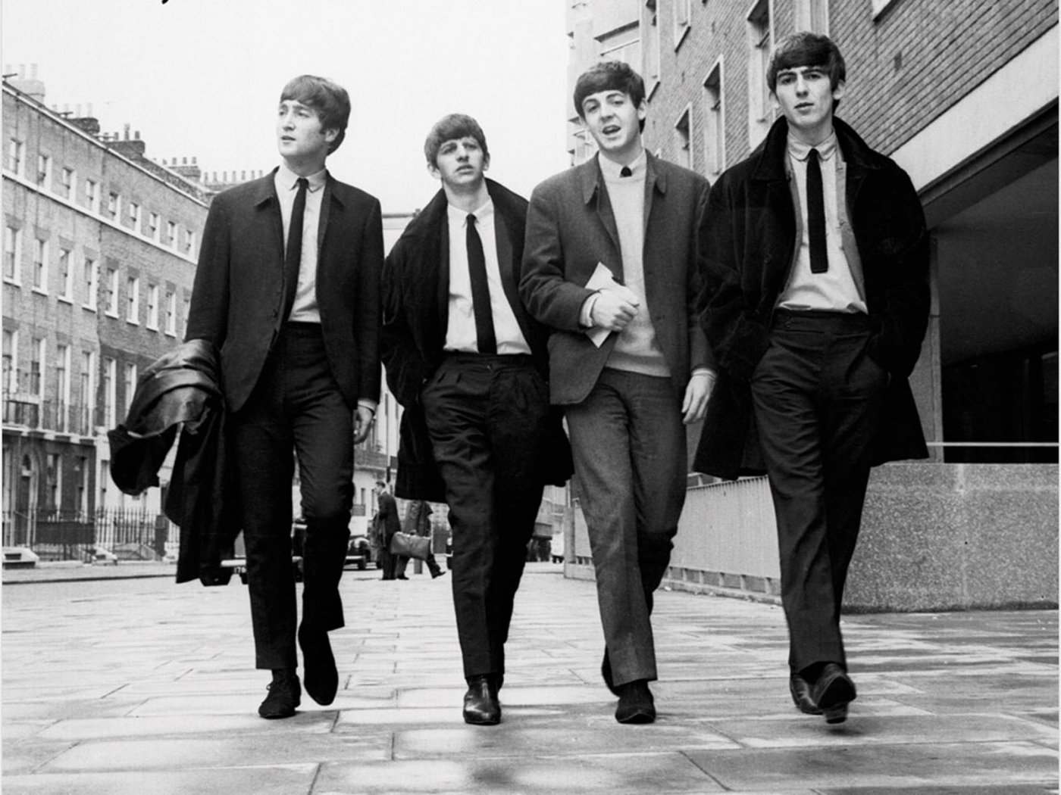
1963 - Beatlemania in the UK
Notes:
1962 - London
Look at this photo. Write down
1. What can you can see?
2. Where the photo was taken?
3. Do The Beatles look the same as they did in Hamburg. What is different?
4. Describe each Beatle. What are they wearing? Facial expression? Hair cut?
5. The Beatles are sometimes described as the first ‘boy band? Why? How are they similar? How are they different?
From The Beatles Teaching Pack (£3.99) 20% teacher discount with coupon code Q4XL4K3

Slide 3
1963: British Beatlemania
Notes:
The Beatles began 1963 playing their last concert at the Star Club in Hamburg. By the end of the year they were the most successful British pop group of all time. This films captures some of the excitement of the year that Beatlemania swept across the UK.
Before Watching Activity
You are going to see a video news clip of 'Beatlemania' in 1963
1. What do you think Beatlemania is?
2. Which of these do you not expect to see?
Screaming girls * Screaming boys * The Beatles in concert * A teddy bear
Taken from The Beatles Teaching Teaching Pack
20% teacher discount on all ESOL Teaching Packs with coupon code Q4XL4K3

Slide 4
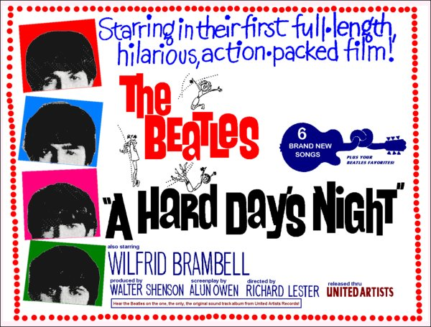
Notes:
1964
Classroom Presentation - Activity
Before You Watch
Ask students to work in pairs/small groups. Look at the poster. What does it tell you about the film? What type or genre is it?
From The Beatles Teaching Pack (£3.99) 20% teacher discount with coupon code Q4XL4K3

Slide 5
Notes:
Classroom Presentation - Activity
Before You Watch
The Beatles filmed their first film, A Hard Day's Night in real locations. Watch the opening scene - discuss with a partner what you can remember.
shows their incredible success in just over a year. The crowds of girls chasing the band around Victoria Station in London are real. Read about the making of the film here (includes Quick Check questions) Everywhere the band goes there is Beatlemania. It scared them but they kept smiling ...
From The Beatles Teaching Pack (£3.99) 20% teacher discount with coupon code Q4XL4K3

Slide 6
1965: Help
Notes:
Classroom Presentation
This promo video is a great introduction how much fun The Beatles were at this time. Ask students to write down any songs they recognise but otherwise just enjoy on first viewing (they are Another Girl, I need You, You've Got to Hide Your Love Away & Help)
Watch a second time:
1. Which places do we see?
2. What did director Richard Lester not want to do?
2. Which country is mentioned? Why did they film there?
From The Beatles Teaching Pack (£3.99) 20% teacher discount with coupon code Q4XL4K3

