Slide 1
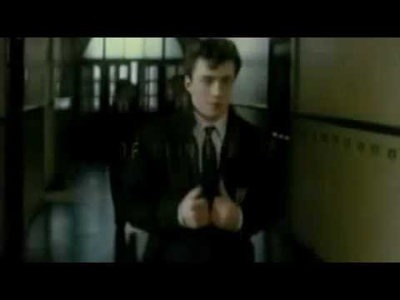
Nowhere Boy
John Lennon had a difficult childhood
Notes:
from The Beatles Teaching Pack & TESOL for Teens
20% teacher discount on all ESOL Teaching Packs with coupon code Q4XL4K3
Classroom Presentation
This trailer for the feature film Nowhere Boy (2010) is a good starting point for understanding the texts & listening activities to follow. The voice over is from the real John Lennon (taken from interviews) but the rest is 'dramatic reconstruction' of real events

Slide 2
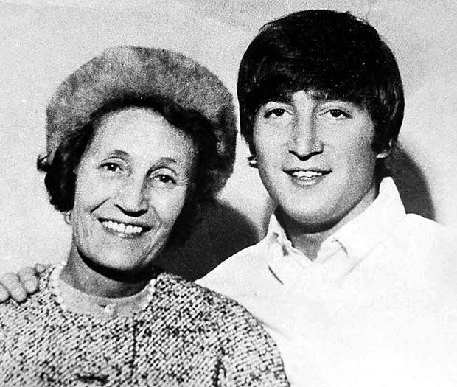
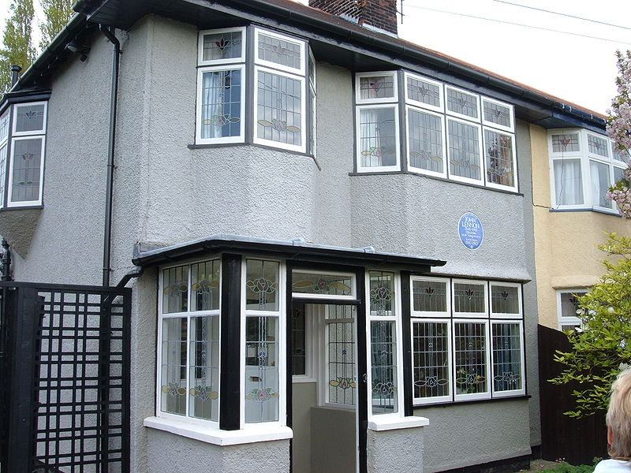
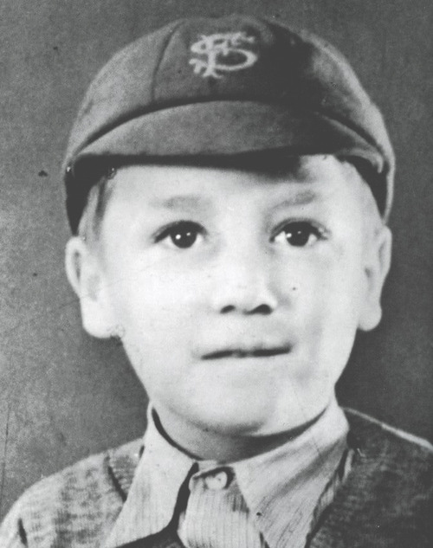
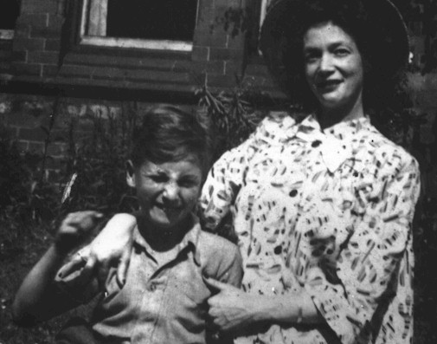
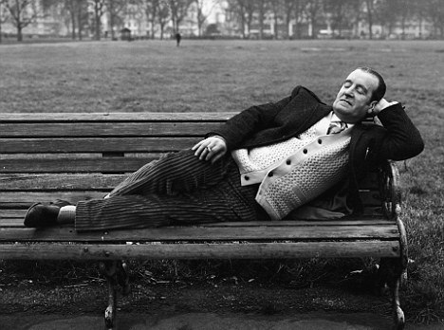
1. Find information about the people & the places in the photos
2. Write a sentence about each photo.
3. Write a paragraph about the childhood of John Lennon
3.
1.
2.
5
4.
Find the information in The Beatles Teaching Pack
Notes:
Taken from The Beatles Teaching Pack
Classroom Presentation
1.(optional) Distribute copies of PDF version of this slide
2. Tell class that John Lennon had a very unusual childhood. Ask students to read about it here.
3. After reading the story can the identify people and places on the slide.
Answers 1. Mendips (Aunt Mimi's house) 2. Earliest photo of John 3. John and Mimi (note that they were a lot closer than often reported) 4. Freddie Lennon (taken after The Beatles were famous) 5. A rare photo of John with his mother (note: John often said his mother came back into his life in his early teens. But he had seen her fairly regularly before that

Slide 3
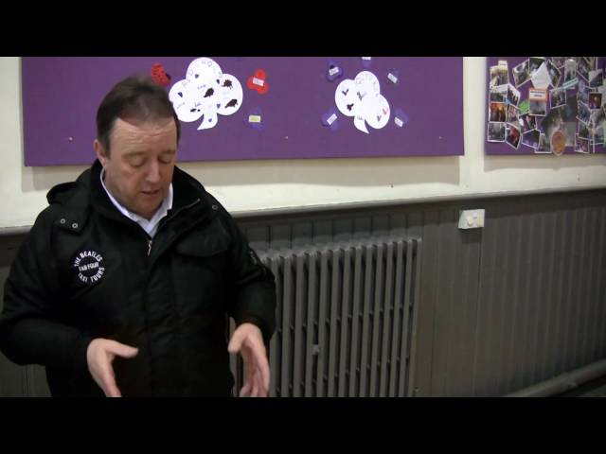
When John met Paul
Woolton, Liverpool: Saturday 6 July 1957
Notes:
Taken from The Beatles Teaching Pack
Before Watching Activity
Explain to class that they will be watching a short presentation about the first meeting between John Lennon and Paul McCartney.
Ask them: What do you know about John and Paul?
Write down
a) three things you know about John.
b) three things you know about Paul
What would you like to know about their first meeting? Write down two questions.

Slide 4
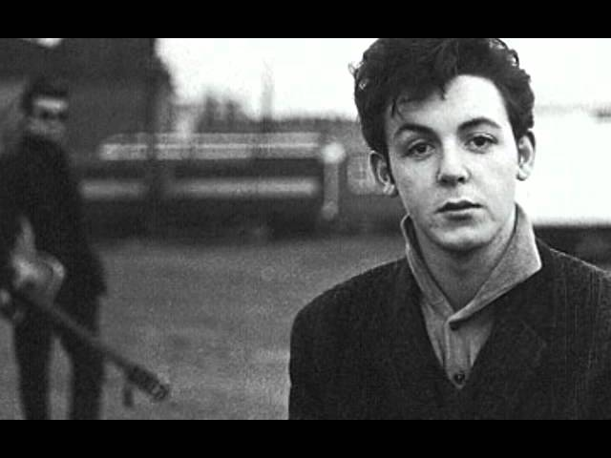
Notes:
Taken from The Beatles Teaching Pack
Classroom Presentation Notes
Pre-teach key vocabulary: Glossary of difficult words:
suburb - residential area away from the centre of city. In the UK/Canada/USA/Australia suburbs are associated with the middle classes.
fete - a party usually held in the grounds of a church for local people.
tune (v) - to tune an instrument is to prepare it for playing. Guitarists need to tune their instruments before every performance.
concept of summer fete to ESOL students. Explain that at this point John is sixteen and lives with his Aunt Mimi in Woolton, a lower-middle class suburb of Liverpool. Paul is fifteen and comes from a neighbouring council estate.
Tapescript: Thei first meeting between John Lennon and Paul McCartney tells us a lot about their relationship. In many ways the boys are very different but they are drawn to each other.
John Lennon is the leader of the group. At sixteen he is already a charismatic figure on stage. In the photograph he is the one we look at. He is creative and changes the words he can't remember. But he is also a little lazy and doesn't tune his guitar
The alcohol on his breath shows the 'wild' side of Lennon’s character. Boys admire him. Girls find him attractive.
John Lennon quickly spots something in McCartney. He notices the younger boy's talent and their similar taste in music.
Lennon's a little jealous, too. Paul McCartney is a potential partner - and rival.
Paul big decision
Paul McCartney also reveals a lot about himself. A natural musician, he is technically better than Lennon. He has the confidence to play guitar for the older boy. He bravely tells John, 'your guitar is out of tune.'
Paul hesitates before joining the Quarrymen. He admires Lennon but notices his ‘dangerous’ side. Typically he takes some time to consider John's invitation. Then he makes one of the most important decisions in the history of pop music.

